Slide 1
CSS342 Data Structures, Algorithms, and Discrete Mathematics (I)

Slide 2
Recursion
Problem A
sub-problem A₁
sub-problem A₂
sub-problem A₃
…
sub-problem A_{N}
Solution

Slide 3
Recursion
Problem A
sub-problem A₁
sub-problem A₂
sub-problem A₃
…
sub-problem A_{N}
Solution
1
1
1
1
1
2
3
4
1
3
6

Slide 4
Recursion
Problem B
sub-problem B₁
sub-problem B₂
sub-problem B₃
…
sub-problem B_{N}
Solution

Slide 5
Recursion
Problem B
sub-problem B₁
sub-problem B₂
sub-problem B₃
…
sub-problem B_{N}
Solution

Slide 6
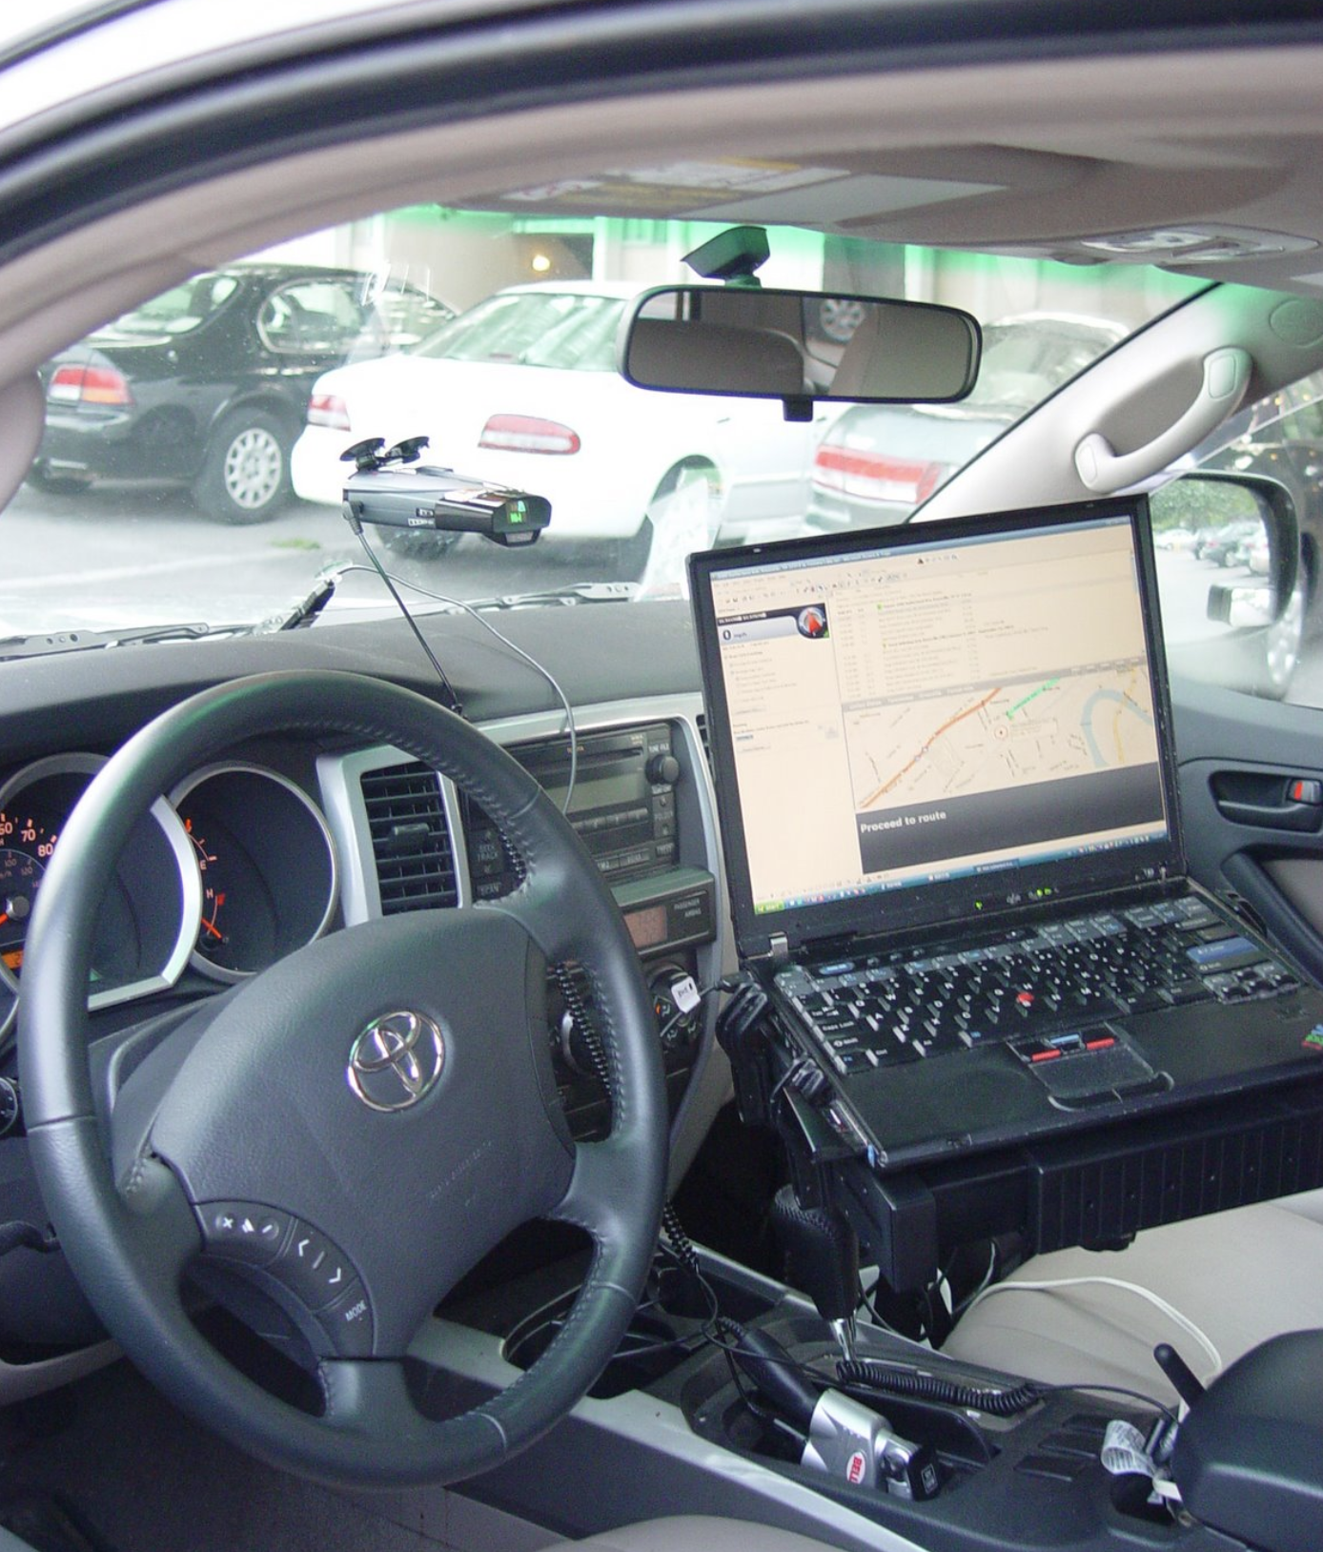
Backtracking
Kayaking trip
Fontana Lake, 07/03/2007

Slide 7
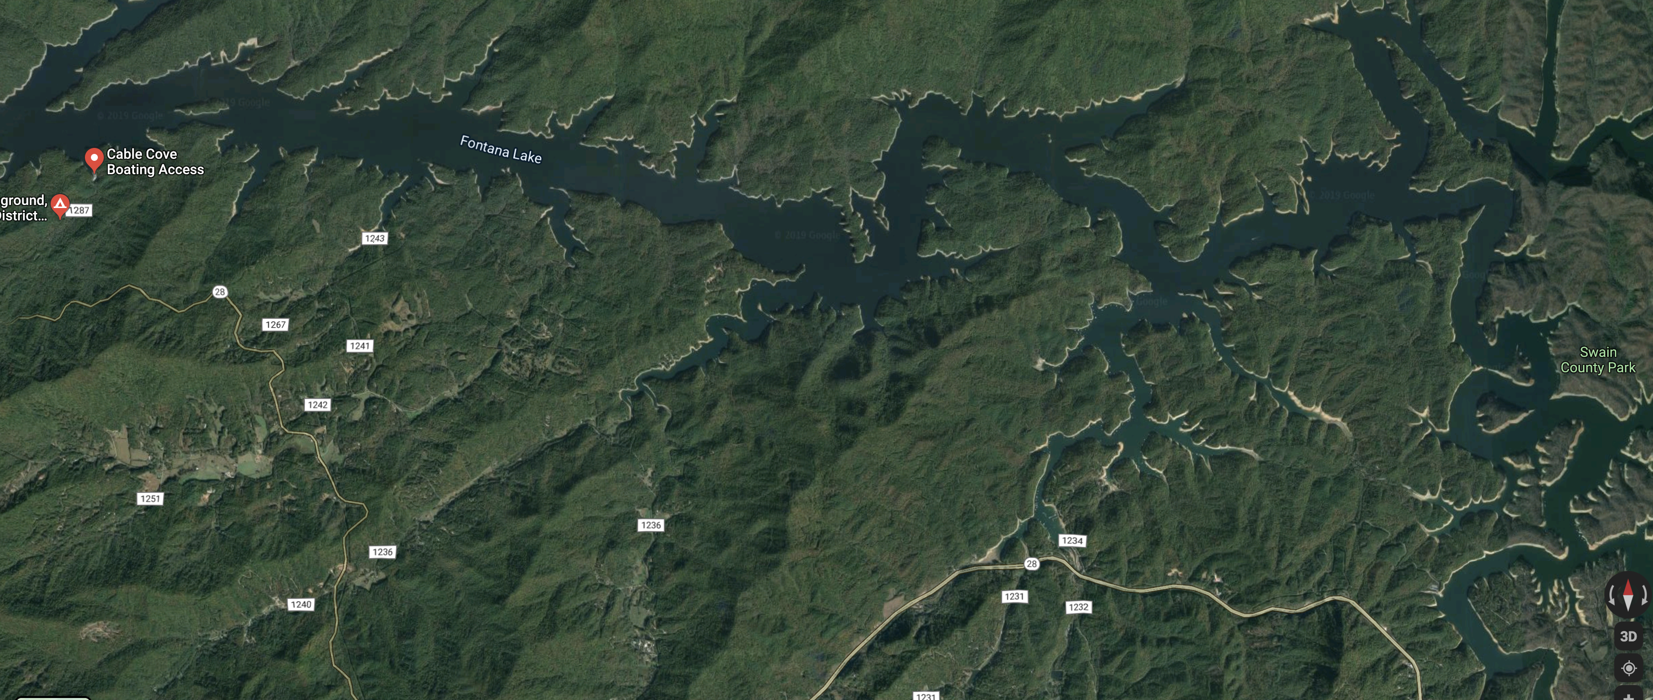
Backtracking

Slide 8
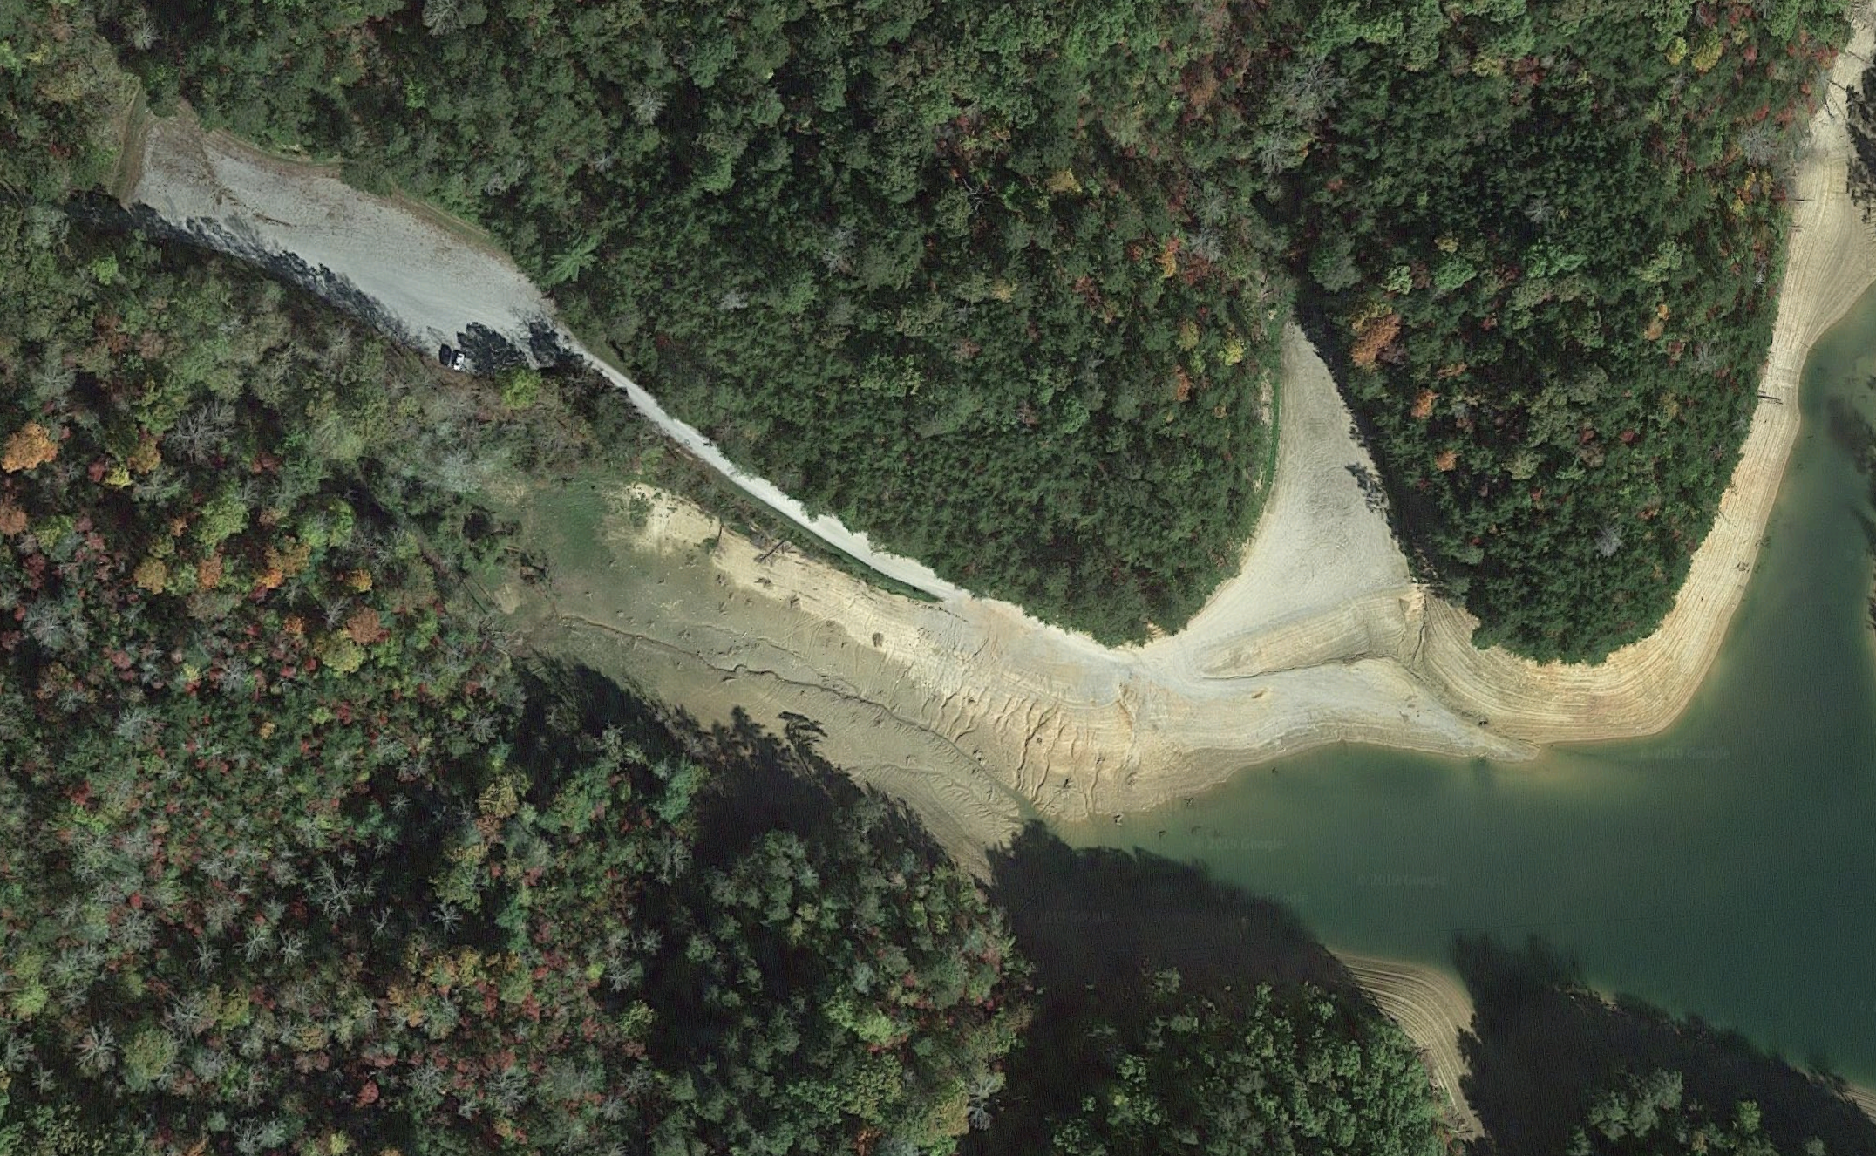
Backtracking

Slide 9

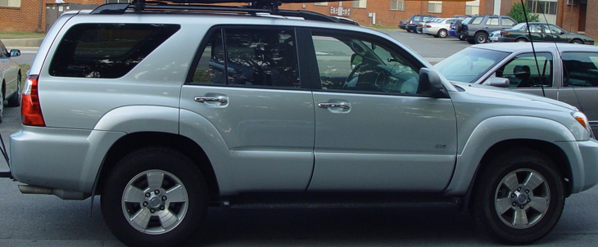
Backtracking

Slide 10
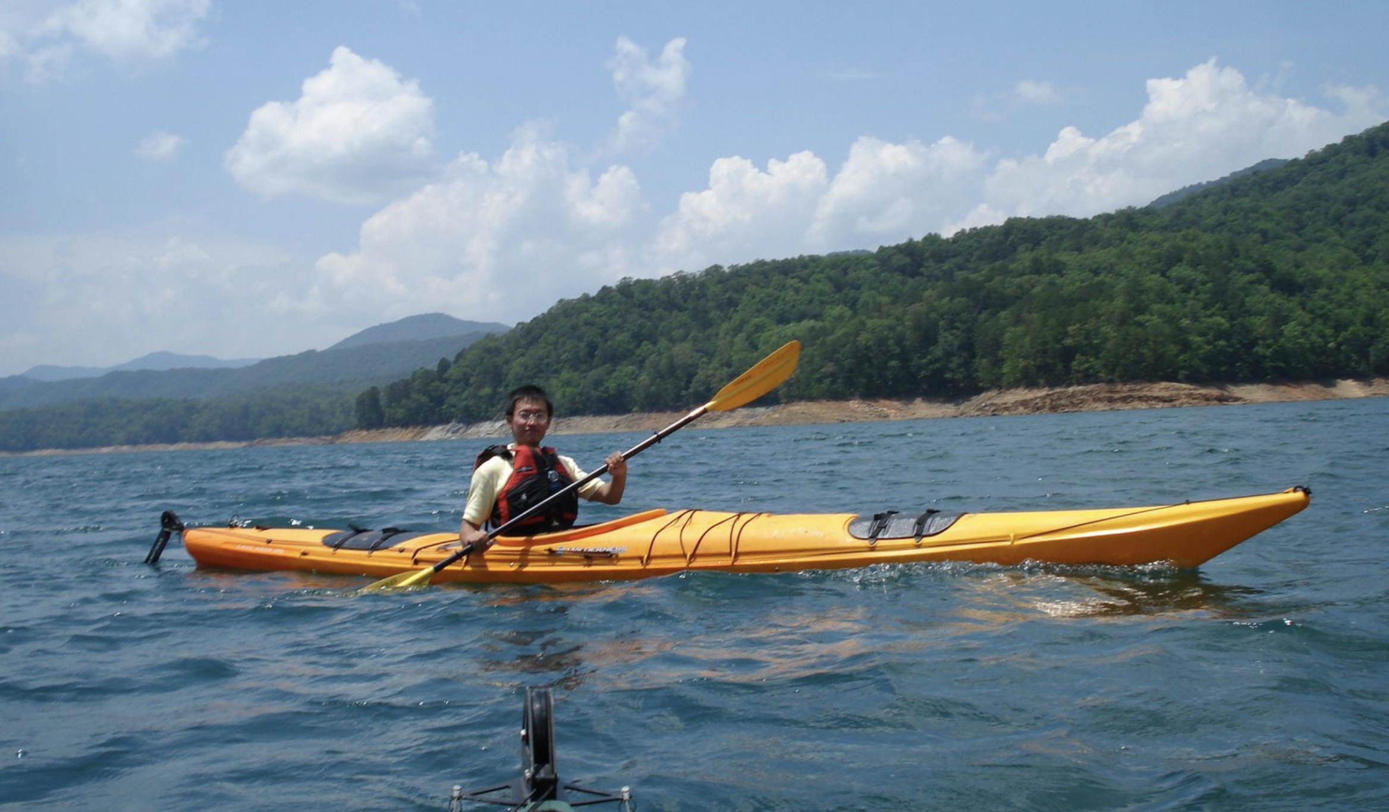
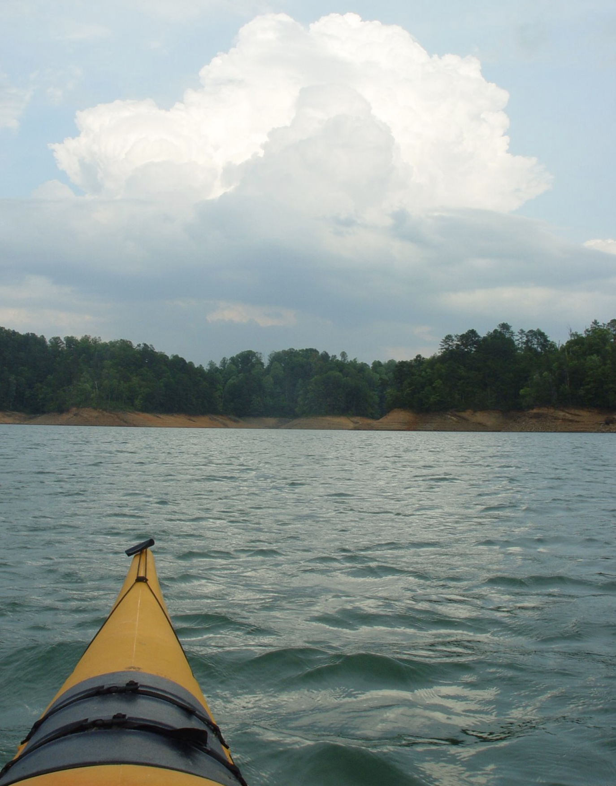
Backtracking

Slide 11
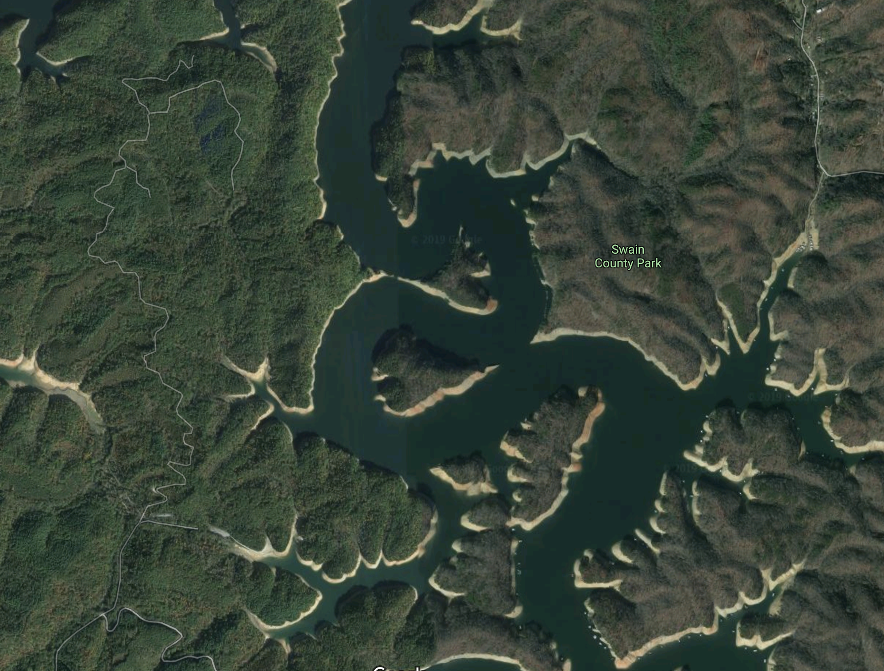
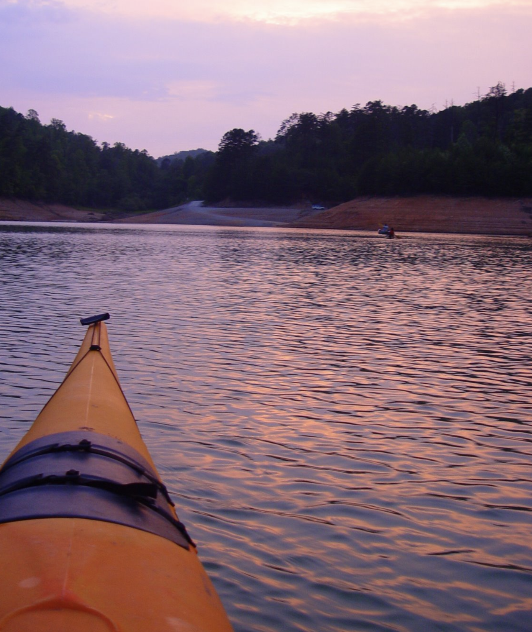

Backtracking

Slide 12
Backtracking
Start from starting point
Move forward if there’s only one possible path
When there’s a fork, go with one of paths
If it too far, return (backtrack) to the fork, and try the other paths

Slide 13
Backtracking

Slide 14
Backtracking
TOO FAR!

Slide 15
Backtracking
NOP!

Slide 16
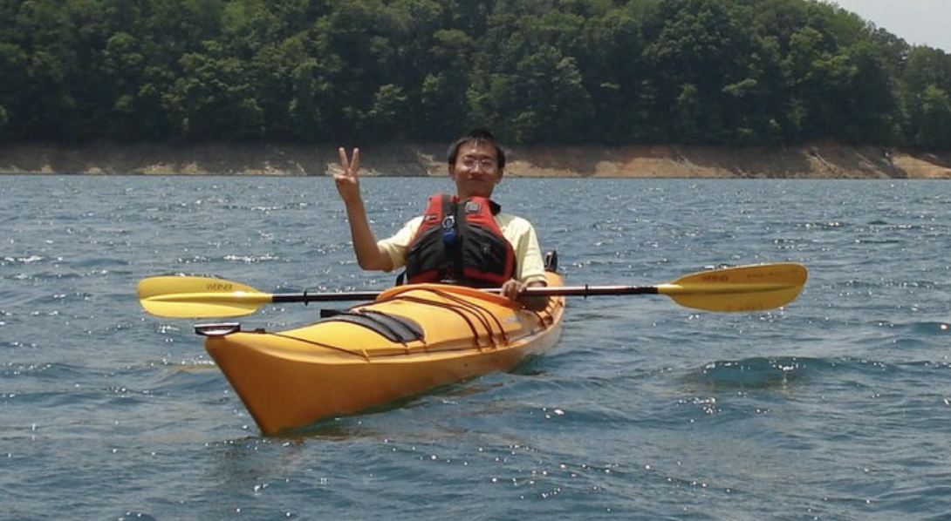
Backtracking

Slide 17
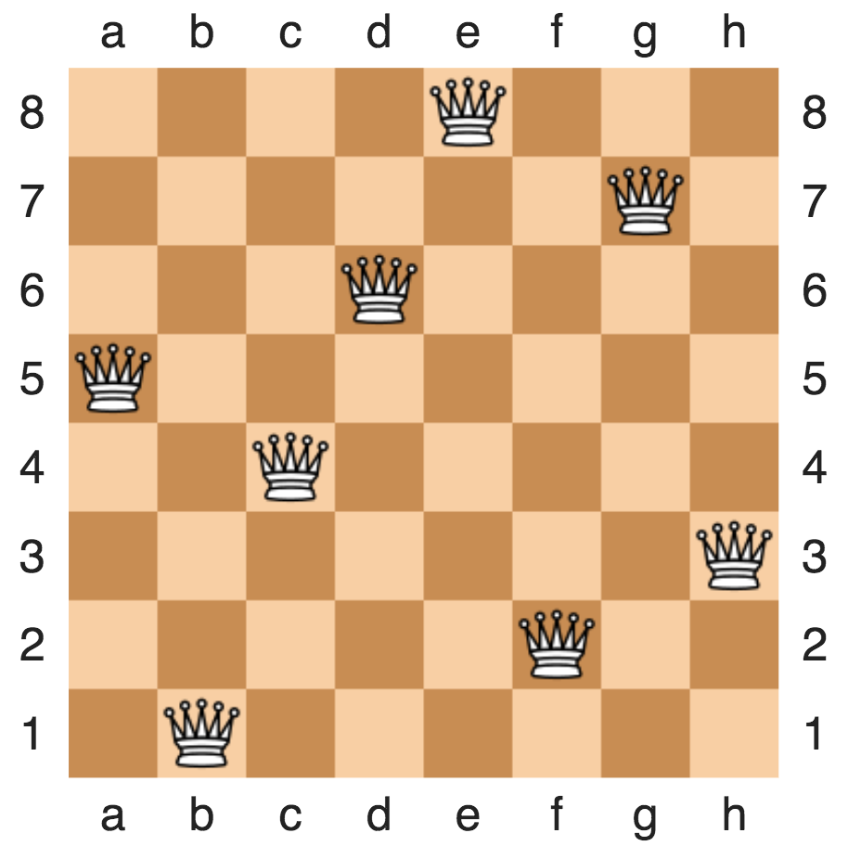
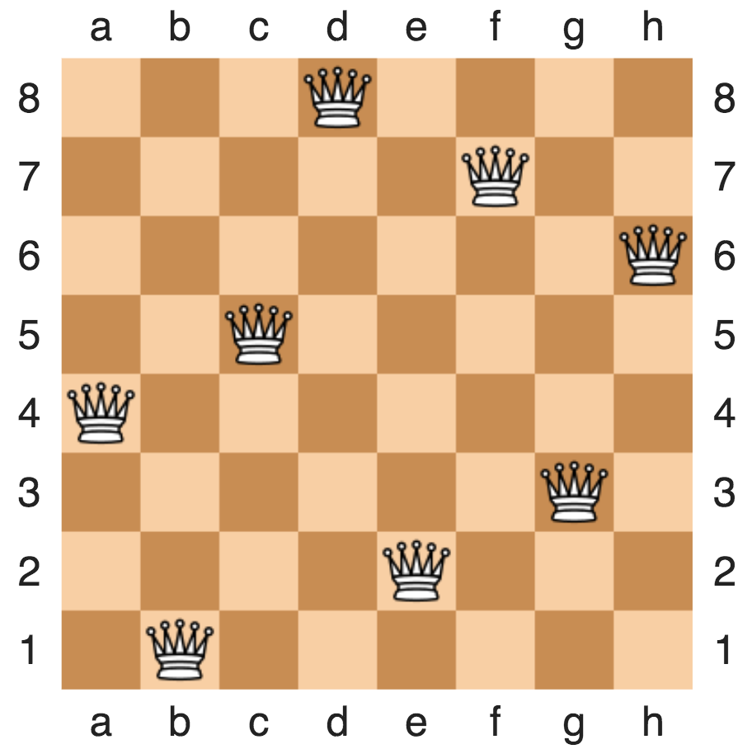
Backtracking example: 8-queue problem
Placing eight queens on an 8×8 chessboard
None of them attack one another
no two are in the same row, column, or diagonal
https://en.wikipedia.org/wiki/Eight_queens_puzzle

Slide 18
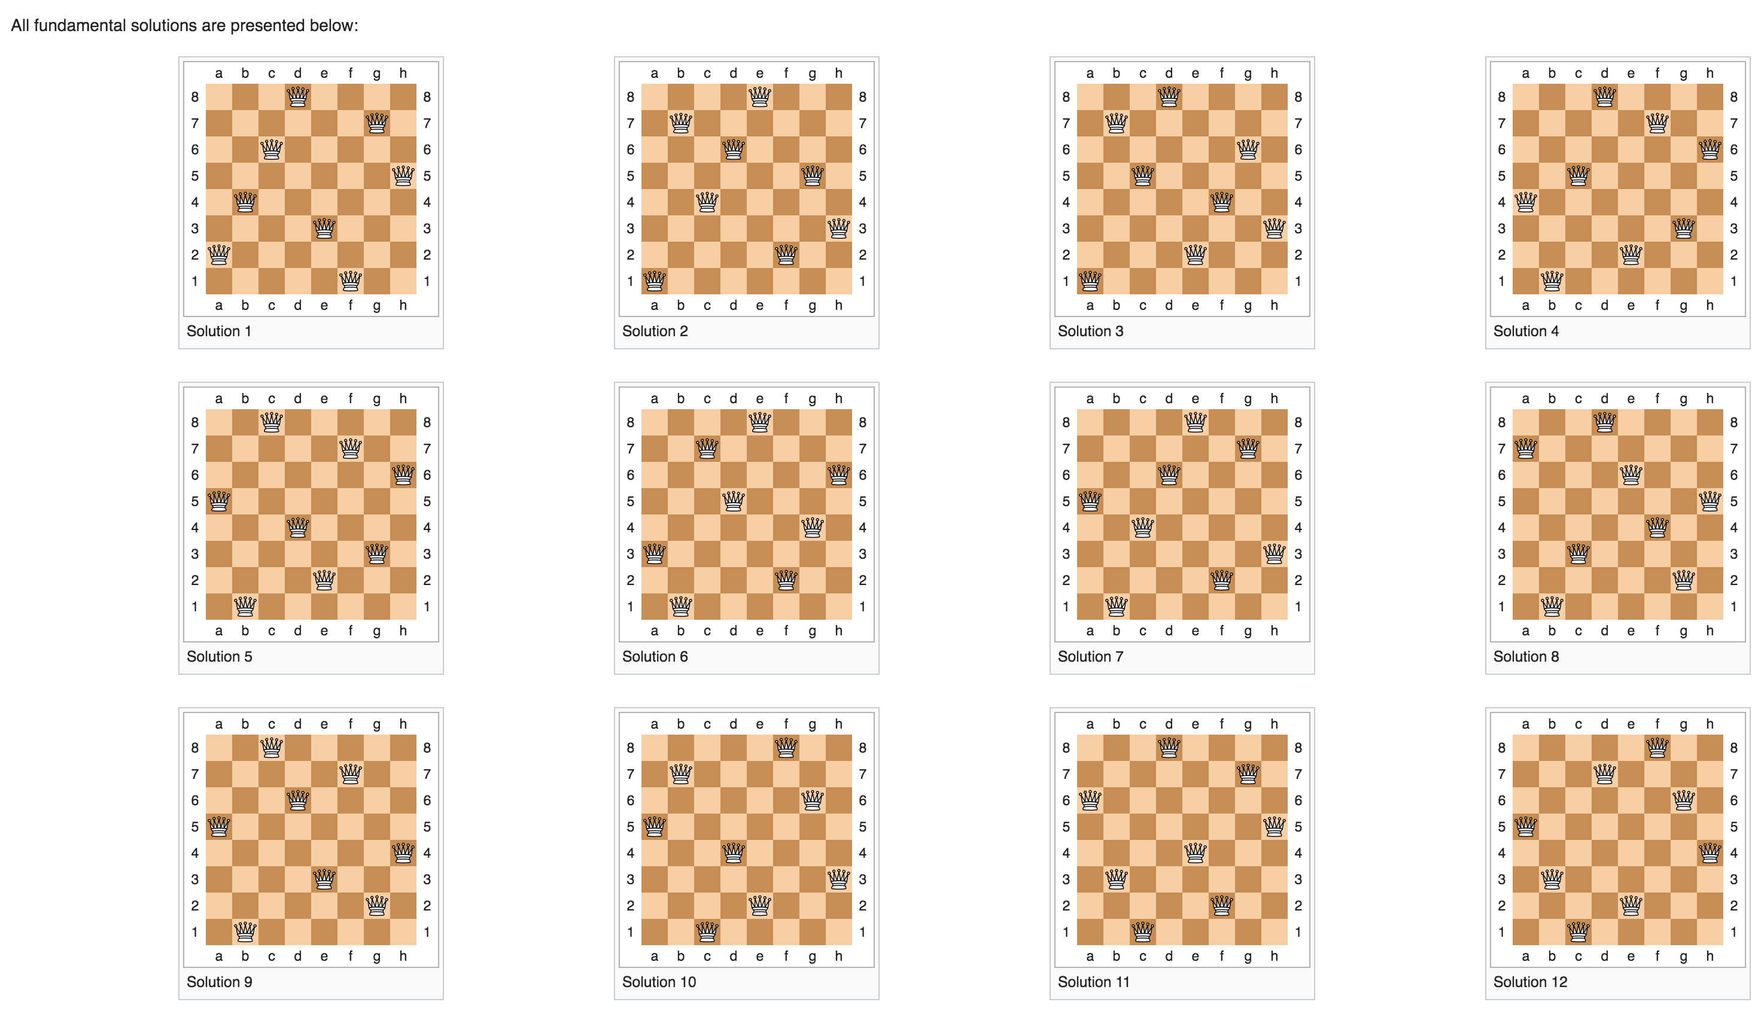
Backtracking example: 8-queue problem
Placing eight queens on an 8×8 chessboard
None of them attack one another
no two are in the same row, column, or diagonal
https://en.wikipedia.org/wiki/Eight_queens_puzzle

Slide 19
Backtracking example: N-queue problem
Placing eight queens on an N×N chessboard
None of them attack one another
no two are in the same row, column, or diagonal

Slide 20
Annimation at http://www.brainmetrix.com/8-queens/

Slide 21
Backtracking example: sudoku solver
9 x 9 grid
Each row and column contain all numbers from 1 to 9
There are 9 3x3 panels in the grid, starting with the upper left-hand corner. No 3x3 panel may contain the same number twice.
https://en.wikipedia.org/wiki/Sudoku

Slide 22
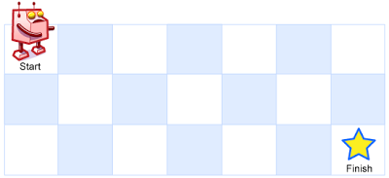
Recursion In Class Exercise
A robot is located at the top-left corner of a m x n grid (marked 'Start' in the diagram below).
The robot can only move either down or right at any point in time. The robot is trying to reach the bottom-right corner of the grid (marked 'Finish' in the diagram below).
How many possible unique paths are there?
https://leetcode.com/problems/unique-paths/

Slide 23
Recursion In Class Exercise
A robot is located at the top-left corner of a m x n grid (marked 'Start' in the diagram below).
The robot can only move either down or right at any point in time. The robot is trying to reach the bottom-right corner of the grid (marked 'Finish' in the diagram below).
How many possible unique paths are there?
1
1
1
1
2
1

Slide 24
Recursion In Class Exercise
1
1
1
1
1
1
2
3
4
5
1
3
6
10
15
Can you solve this without using recursion?

Slide 25
Backtracking Example
A robot is located at the top-left corner of a m x n grid (marked 'Start' in the diagram below).
The robot can only move either down or right at any point in time. The robot is trying to reach the bottom-right corner of the grid (marked 'Finish' in the diagram below).
Print out the possible paths

Slide 26
Backtracking: all possible paths
[0, 1, 2]
[0, 1, 2, 5]
0
1
2
0
1
2
[0, 1]
3
4
5
3
4
5
0
1
2
[0, 1, 4]
[0, 1, 4, 5]
[0]
3
4
5
0
1
2
0
1
2
0
0
1
1
2
2
3
4
5
3
4
5
4
4
5
3
5
3
[0, 3]
[0, 3, 4]
[0, 3, 4, 5]
0
1
2
0
1
2
0
1
2
3
4
5
3
4
5
3
4
5

Slide 27
Backtracking: all possible paths
[0, 1, 2] (M=1, N=2)
[0, 1, 2, 5] (M=1, N=1)
0
1
2
0
1
2
[0, 1] (M=2, N=2)
3
4
5
3
4
5
0
1
2
[0, 1, 4] (M=2, N=1)
[0, 1, 4, 5] (M=1, N=1)
[0] (M=3,N=2)
3
4
5
0
1
2
0
1
2
0
0
1
1
2
2
3
4
5
3
4
5
4
4
5
3
5
3
[0, 3] (M=3, N=1)
[0, 3, 4] (M=2, N=1)
[0, 3, 4, 5] (M=1, N=1)
0
1
2
0
1
2
0
1
2
3
4
5
3
4
5
3
4
5

Slide 28
Backtracking Example
How to represent 2D array?
“Column major” : stores column by column
0
1
2
N=2 rows
3
4
5
M=3 columns
0
3
1
4
2
5
Data at location column i, row j : array[j*N+i]

Slide 29
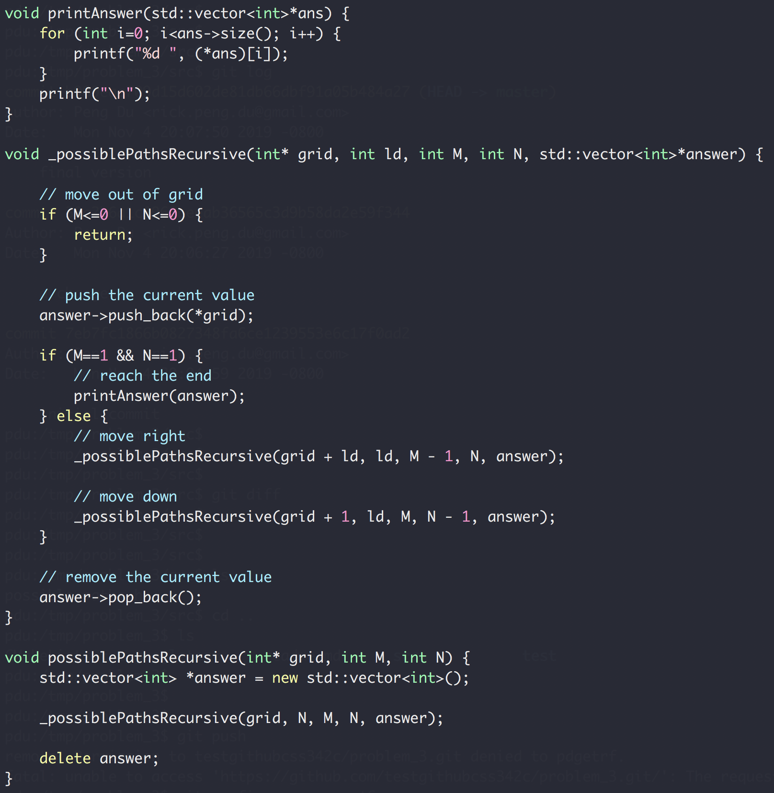

Slide 30
Backtracking Example
Write a function to generate all possible N pairs of balanced parentheses.
N=1 → { }
N=2 → { } { } { { } }
{ } { } { }
{ } { { } }
{ { } } { }
{ { } { } }
{ { { } } }
N=3 →

Slide 31
Backtracking Example
Write a function to generate all possible N pairs of balanced parentheses.
Balanced: number of open parenthesis >= number of close parenthesis
{ { _{(2,0)}
{ { } _{(2,1)}
{ { } } _{(2,2)}
{ _{(1,0)}
{ } _{(1,1)}
{ } { _{(2,1)}
{ } { } _{(2,2)}

Slide 32
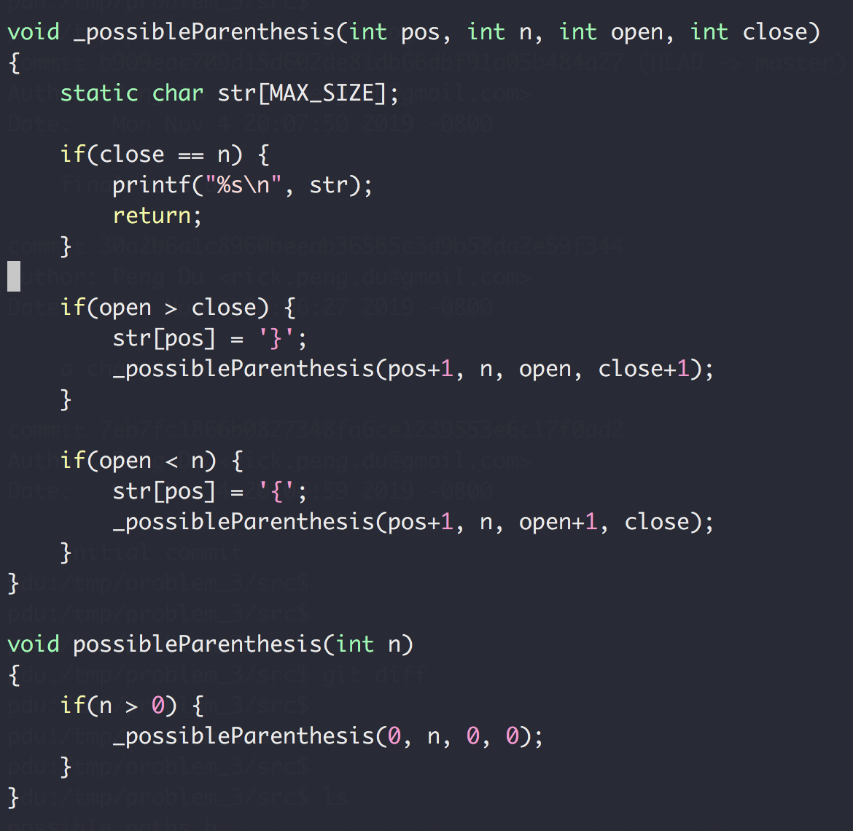
Backtracking Example
Write a function to generate all possible N pairs of balanced parentheses.

Slide 33
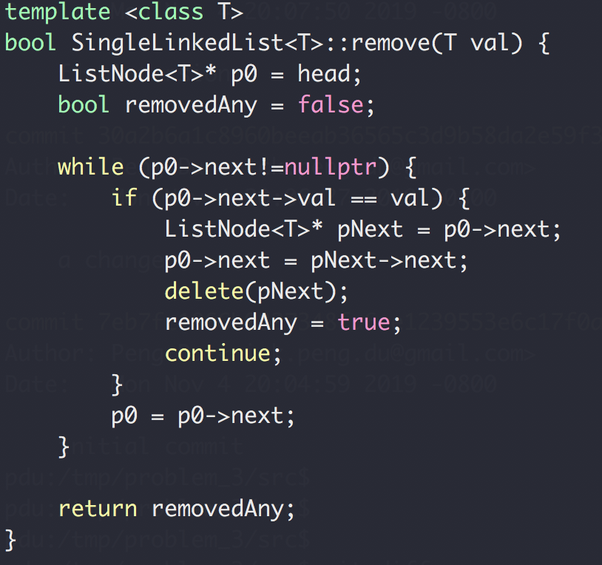
Homework Review
Remove()
head
Next
Next
Next
Next
end

Slide 34
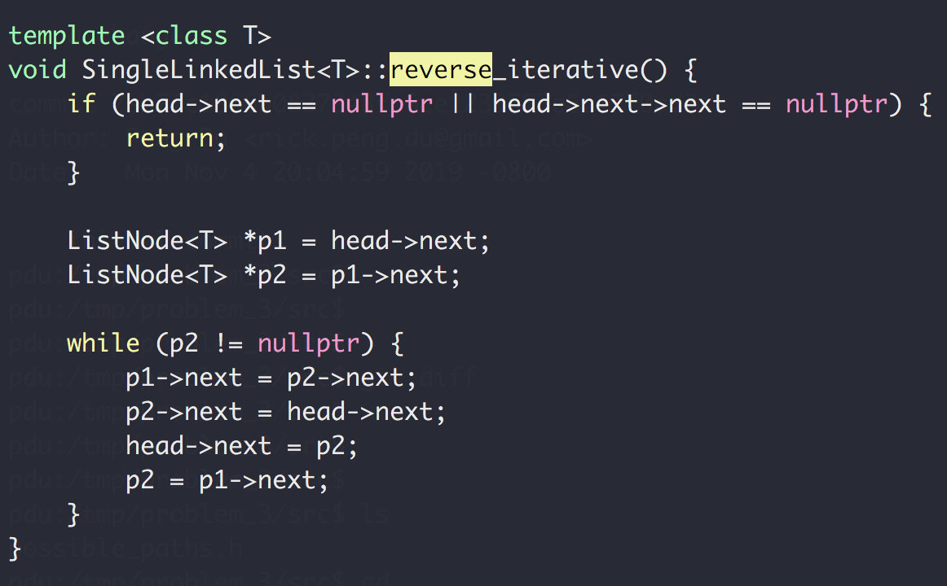
Homework Review
reverse_iterative()
h → 1 → 2 → 3 → 4 → N
h → 2 → 1 → 3 → 4 → N
h → 3 → 2 → 1 → 4 → N
h → 4 → 3 → 2 → 1 → N

Slide 35
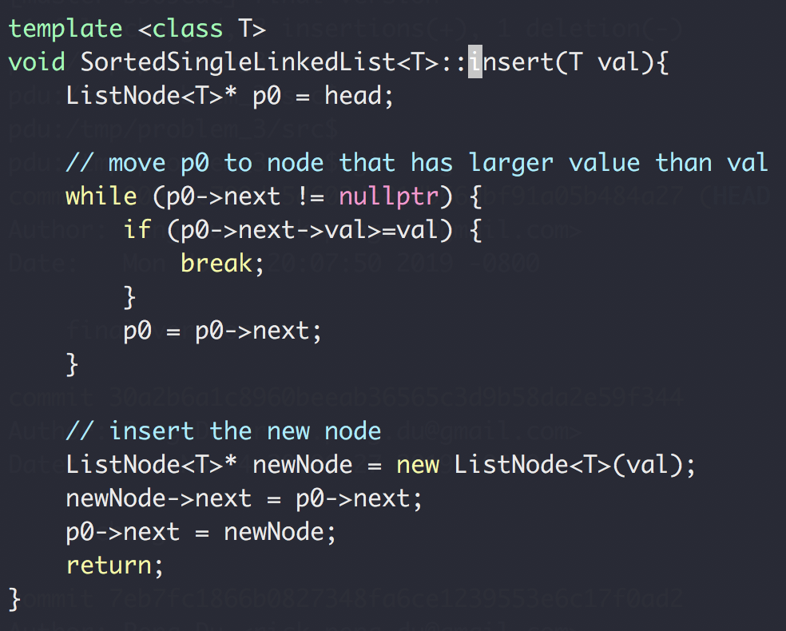
Homework Review
Insert into sorted single linked list
h → 3 → 6 → 9 → N
Insert 5
h → 3 → 5 → 6 → 9 → N

Slide 36
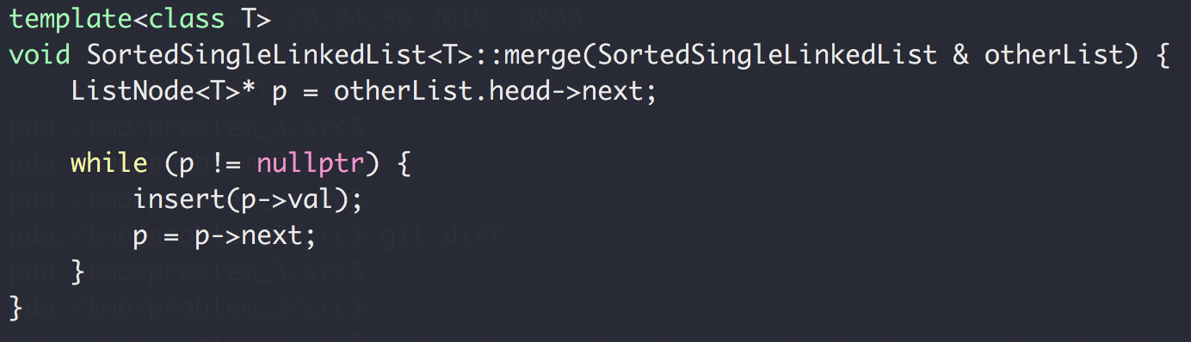
Homework Review
Merge sorted single linked list
h → 3 → 6 → 9 → N
otherList: h → 2 → 5 → 10 → N
h → 2 → 3 → 5 → 6 → 9 → 10 → N

Slide 37
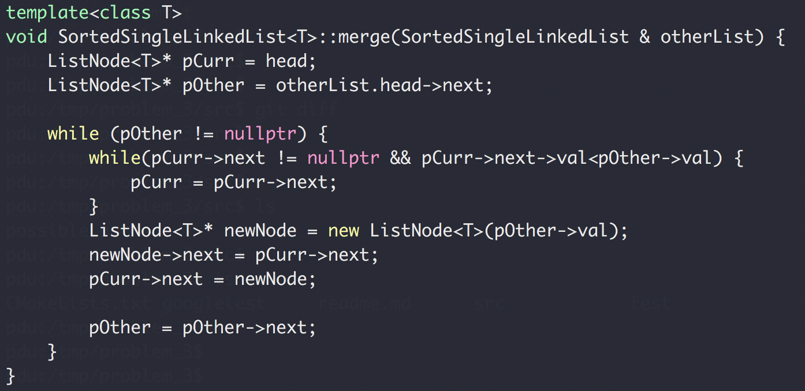
Homework Review
Merge sorted single linked list
h → 3 → 6 → 9 → N
otherList: h → 2 → 5 → 10 → N

